Slide 1

COEN 243: Internet of Things
Department of Computer Engineering
Santa Clara University
Remote IoT Weather Sensor Station
Colton Powell, Matthew Salmanpour, Justin Visas, Yezhou Zhao
Advisor
Behnam Dezfouli
June 2018

Slide 2
Introduction

Slide 3
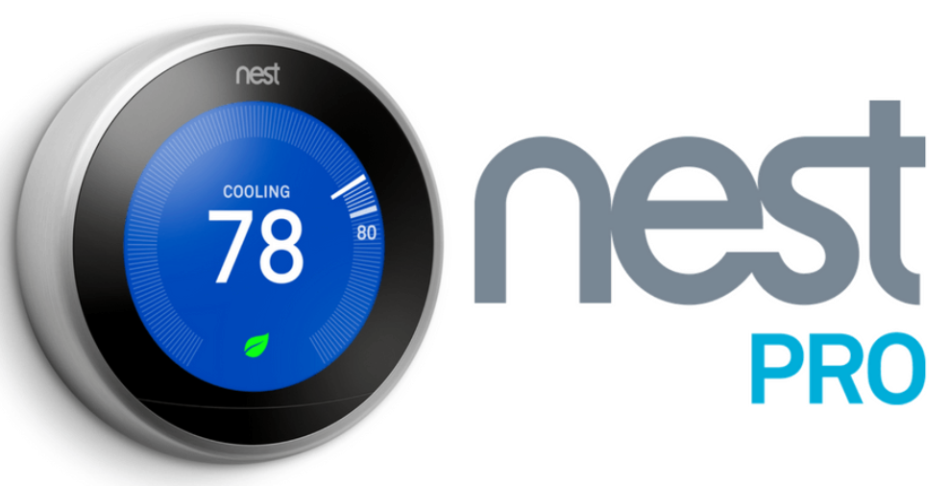
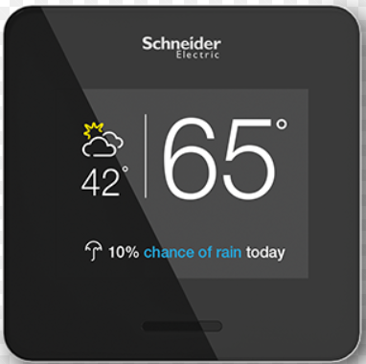
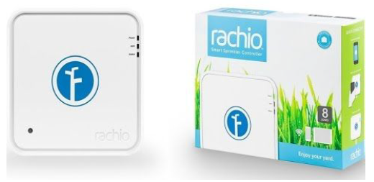
Introduction
Problem Statement
Intelligently automating functions in smart home, agricultural and horticulture applications such as turning on sprinklers, enabling HVAC, and adjusting blind position would be very valuable, but the sensor data needed to make these decisions is not always readily available
Significance
Americans waste $130B of energy per year in homes and businesses
Heating and cooling account for 48% of energy consumptions in homes
60% of water dumped/diverted for irrigation is wasted
Existing Solutions and Companies Working in This Domain
Nest Wi-Fi Thermostat
Wiser Air Wi-Fi Thermostat
Smart Wi-Fi Sprinkler
Notes:
Matt

Slide 4
Remote IoT Weather Sensor Station

Slide 5
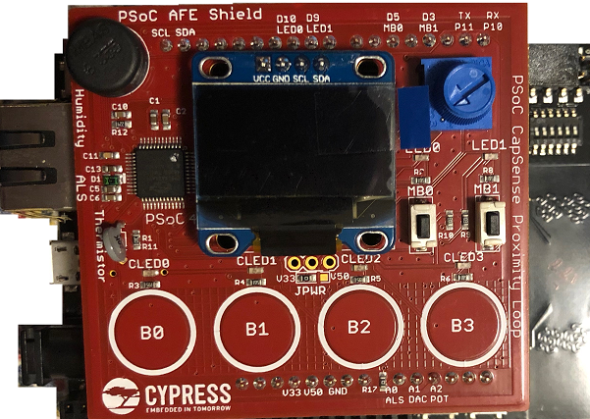
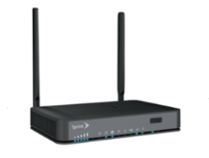

Proposed Solution
Remote IoT Weather Sensor Station
Complete System Diagram -
MQTT Messages
Browser Clients
Cypress Wi-Fi Kits
(MQTT Publishers)
Gateway
IOT-CPS-COURSE-2G
Internet
Mosquitto
(MQTT Broker)
HTTP Server
AWS EC2 Server
Notes:
Colton

Slide 6
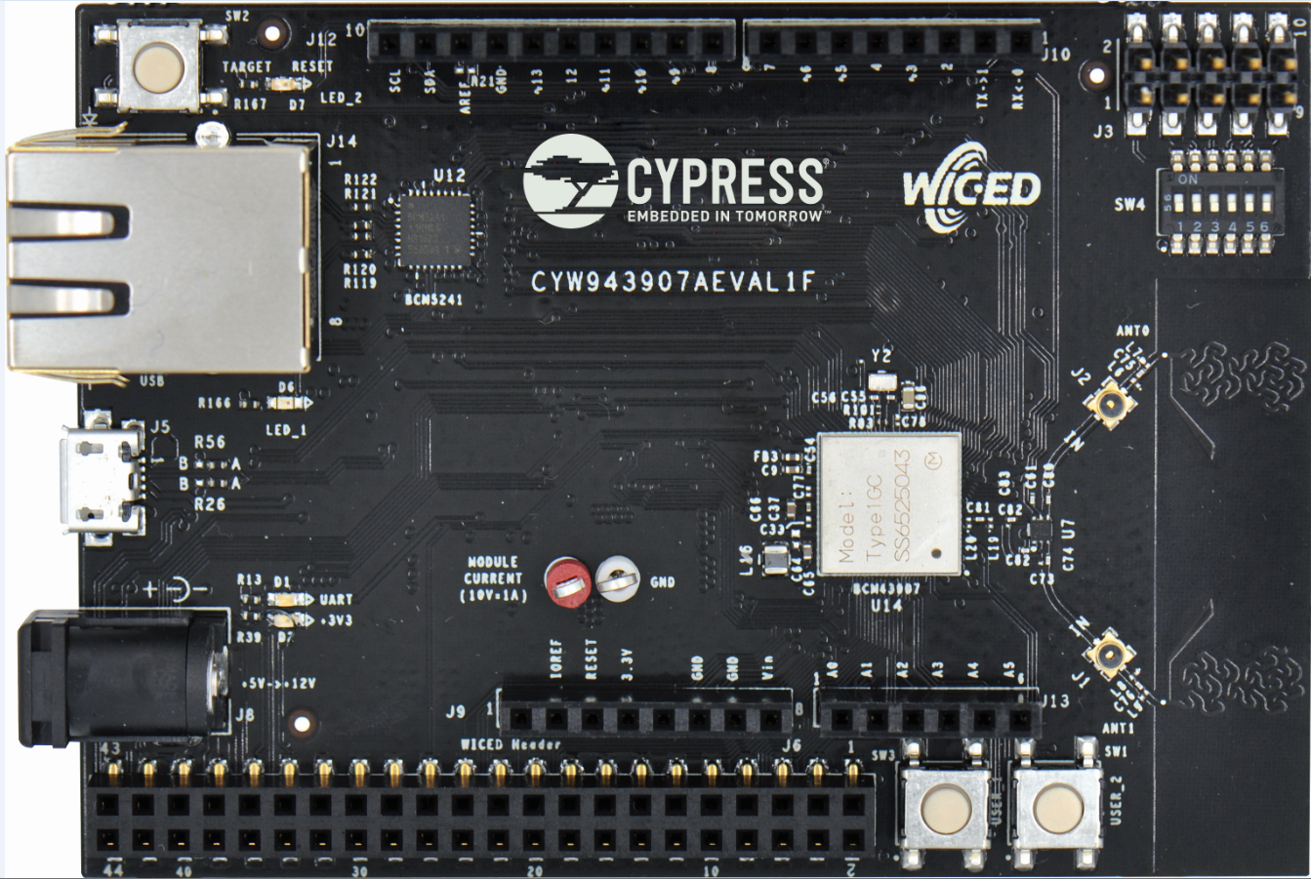
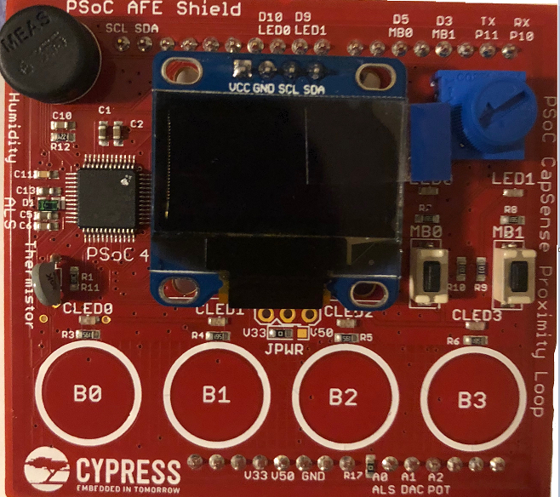


Proposed Solution
Remote IoT Weather Sensor Station
System Diagram – Hardware Overview
Data Struct where data sent over I2C
Messages from AFE Shield to Cypress Wi-Fi Board:
{
float humidity;
float temperature;
float potentiometer_position
float luminosity; }
Cypress WICED® Wi-Fi CYW43907 Eval Kit
Murata 1GC Wi-Fi Module
Hosting Cypress’ CYW43907 802.11b/g/n Wi-Fi SoC
PSoC® AFE Shield
Humidity Sensor
Potentiometer
Light Sensor
Temperature Sensor
Notes:
Matt

Slide 7

Proposed Solution
Remote IoT Weather Sensor Station
System Diagram - Web Page Subscriber
Browser Clients
HTTP Requests:
Browser requests web page, allowing it to act as MQTT Subscriber.
Now, browser is allowed to receive weather data and draw graphs accordingly.
Internet
HTTP Response:
Webpages sent to and received by clients.
Mosquitto (MQTT Broker)
HTTP Server
AMAZON EC2 SERVER
Notes:
Justin

Slide 8
MQTT Subscriber Browser Client
Displays charts containing information about the weather station: temperature, humidity, luminosity, and potentiometer readings
There are separate charts for each of these statistics
4 Charts per weather station
Dynamically creates charts for new devices; destroys charts for disconnected devices
Updates every time an MQTT message is received
Created using HTML + Javascript.
Javascript Libraries used:
Paho MQTT: Allows the webpage to function as a MQTT client (subscriber in this case)
Chart.js: Used to draw line charts containing weather station information
Aes-js: For security
Notes:
Colton

Slide 9

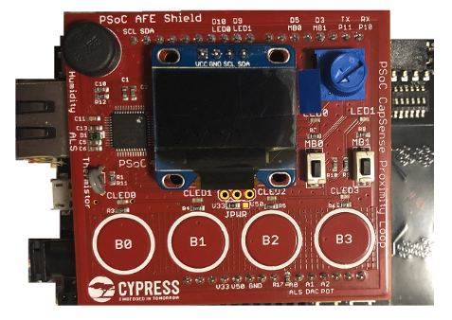
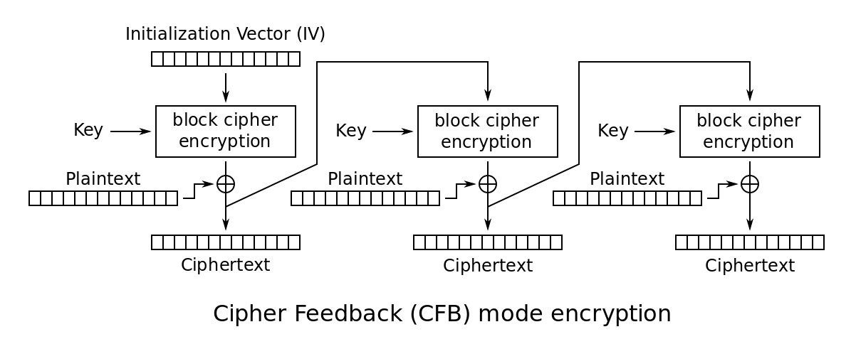
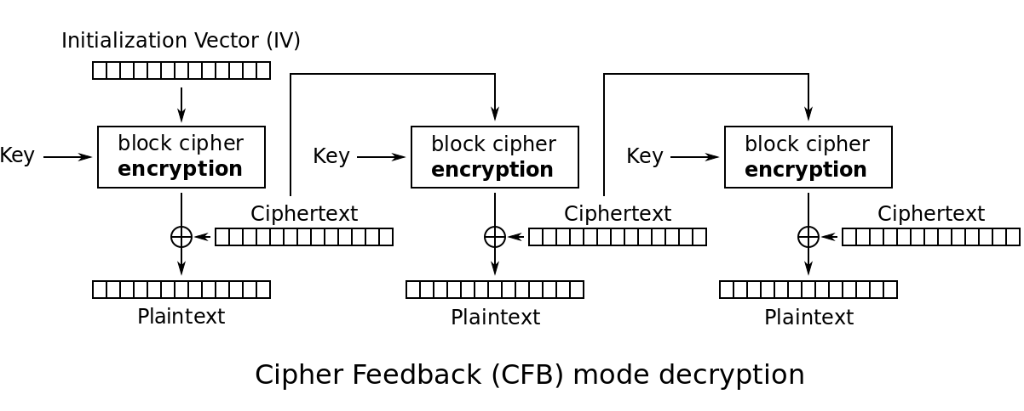
Proposed Solution
Remote IoT Weather Sensor Station
System Diagram – Encryption
MQTT Broker, Web Server
Cypress Board
Web Client
MQTT Publisher
MQTT Subscriber
Ciphertext Sent
Ciphertext Received
Cleartext
Cleartext
Notes:
Patrick

Slide 10
Evaluation

Slide 11
Evaluation
Remote IoT Weather Sensor Station
System evaluation to ensure valid sensor data and system functionality:
Connection Test:
Adding/removing Wi-Fi kits to the network to test dynamic expansion of sensor graphs on browser clients
Humidity Test:
Breathing on humidity sensor on board to see changes in data
Temperature Test:
Breathing on temperature sensor on board to see changes in data
Luminosity Test:
Covering and shining light on light sensor on board and checking for the appropriate actions in the data
Potentiometer Test:
Adjusting position of potentiometer to see changes in data
Remote IoT Weather Sensor Station Demo Video on next slide
Notes:
Justin

Slide 12
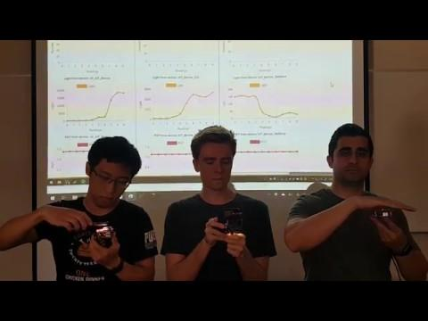
Evaluation
Video Demo

Slide 13
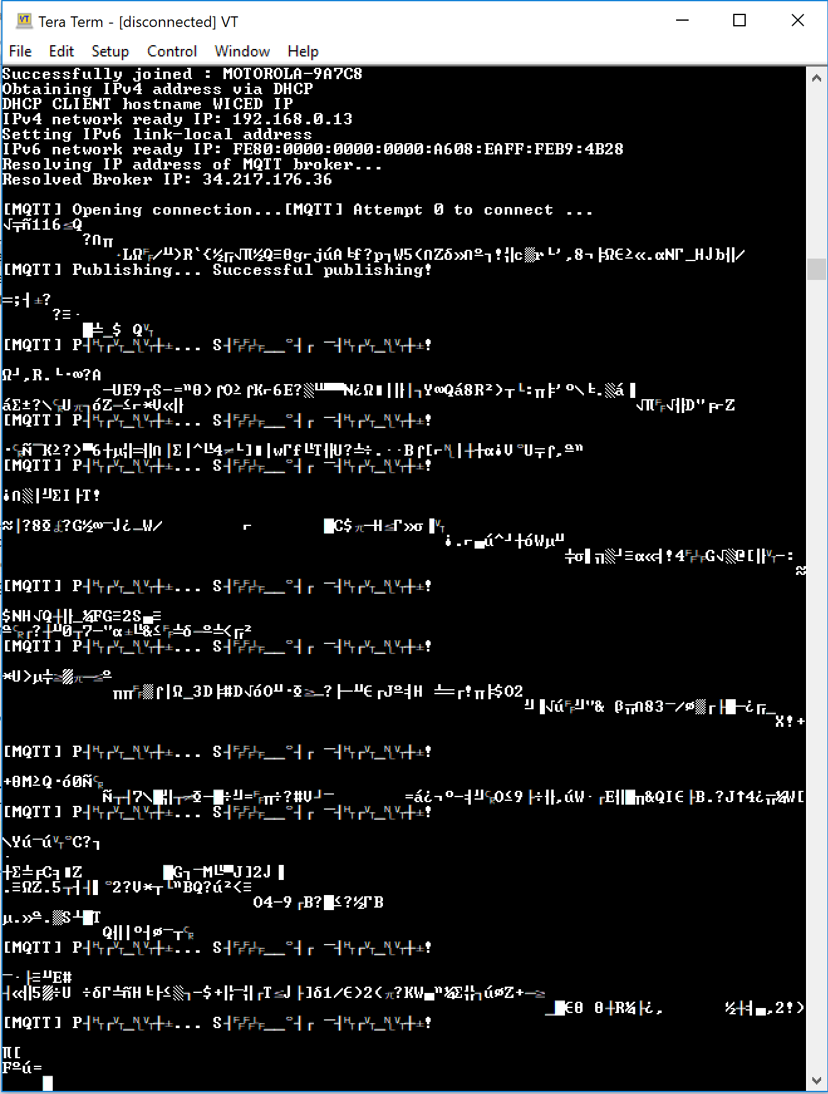
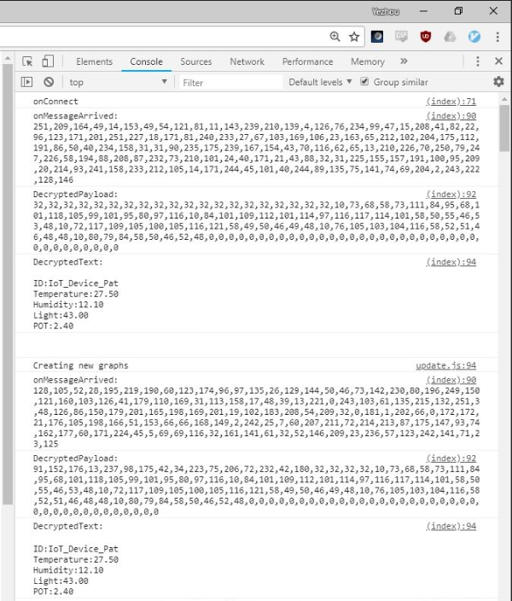
Encryption Results
Cypress Board Serial Out (MQTT Publisher)
Web Browser Console (MQTT Subscriber)

Slide 14
Evaluation
Further Potential Development
Applications:
Smart Garden / Greenhouse
Smart Climate Control in Homes
Smart Farms
Functionality:
Additional Sensor Types
Switching Capabilities
GPS Reporting Capabilities
Bluetooth Integration
Visualizations:
Mobile App
Improved UI
Additional Statistics and Analyses
Device Health and Location Tracking
Notes:
Justin

Slide 15
References
AWS. “AWS IoT Core Documentation.” Developer Guide, AWS IoT, www.docs.aws.amazon.com/iot/latest/developerguide/what-is-aws-iot.html.
AWS. “Amazon Elastic Compute Cloud Documentation.” Amazon Elastic Compute Cloud Documentation, User Guide for Linux Instances, www.aws.amazon.com/documentation/ec2/.
Cypress Semiconductor. CYW943907AEVAL1F Evaluation Kit User Guide. CYW943907AEVAL1F Evaluation Kit User Guide, Cypress, 2017.
Eclipse, Mosquitto. “Eclipse Mosquitto™ An Open Source MQTT Broker.” Eclipse Mosquitto, Documentation, www.mosquitto.org/.
“Spooky Statistics About Energy And Water Waste.” Www.erc-Co.org/, 13 July 2016, www.erc-co.org/spooky-statistics-about-energy-and-water-waste/.
“Welcome to My Smart Home: The 12 Best Devices to Make Your House Smart.” Fortune, Fortune, www.fortune.com/2017/02/17/smart-home-tech-internet-of-things-connected-home/.

Slide 16
Contributions of Group Members

Slide 17
Contributions of Group Members
Colton Powell
Contributions
Created and administered the Amazon AWS EC2 server and the programs on it (httpd, mosquitto)
Established communications between the IoT boards, the MQTT broker, and instances of the web application
Assured that messages were formatted correctly and that they were correctly parsed and stored by instances of the web application
Dealt with the dynamic creation and removal of graphs.
Challenges
Properly drawing the graphs: Chart.js had a number of options to be set to ensure the graphs were drawn correctly
Dealing with randomly-timed removal of graphs: Javascript is single threaded with essentially no concurrency controls, which made random, shared data structure access a struggle, though we eventually found a solid solution.
Getting the MQTT communication pipeline between IoT boards, the MQTT broker, and instantiations of the web application working flawlessly

Slide 18
Contributions of Group Members
Matthew Salmanpour
Contributions
Project introduction and definition of key target applications as well as value add for each application based on project’s functionality
Evaluation of AWS IoT for project implementation, including successfully publishing and subscribing to MQTT topic in AWS IoT console using Cypress Wi-Fi kit and modifications to WICED SDK example code
Development of further potential areas and applications project can be expanded into as well as validation of sensors used in project
Final report, presentation and demo video content creation and editing
Challenges
Technical issues with establishing MQTT connection with AWS IoT and publisher/subscriber functions. Mitigated using Cypress documentation and additional example code.
Lack of prior networking knowledge and comprehensive programming experience to initially understand all parts of project. Resolved by learning from Colton and additional research on resources outside of lecture notes

Slide 19
Contributions of Group Members
Justin Visas
Contributions
Proposal slides and initial project schedule.
Evaluation of AWS IoT for project implementation for publishing and subscribing to MQTT topic in AWS IoT console using Cypress Wi-Fi kit and modifications to WICED SDK example code.
Made critical decisions for project timing such as demoing and recording to meet project timeline.
Directed test setup and videos to enable optimal system and concept realization from viewer perspective.
Final report, presentation and demo video content creation and editing.
Challenges
Connection issues with AWS IoT and Cypress Eval board. Specifically, connecting to AWS MQTT broker. Met with Dr. Dezfouli and determined root cause is most likely a certification file issue.
Generally inexperienced and unfamiliar with programming and related items in terms of background and knowledge of computer networks and internet architecture. Learned the majority of the background to be able to explain functionality at a system level from Colton / group project meetings.

Slide 20
Contributions of Group Members
Yezhou Zhao
Contributions
Project planning and misc activities - participant
Demonstration video - participant
Final Report - content editing
End to end encryption
Hardware crypto engine on Cypress board
Integrating aes-js crypto library into EC2 server
Encryption slides in presentation
Challenges
Debugging Cypress board without OS or convenient debugging interfaces. Solutions required intuition and trial-and-error approach.
Lack of documentation on hardware crypto engine interfaces and internals. Correct interface header found by comparing Cypress samples for software crypto to available headers in WICED.

